Slide 1
FarmAI AI Assisted app for farmers
2210701202 K Ragavendar
210701203 V Raghav
210701215 M Rohit

Slide 2
Abstract
An inventive web program called FarmAI Companion is using artificial intelligence to transform farming methods.
The app provides tailored suggestions for resource management, agribusiness practices, and crop selection.
Using climatic data, past crop performance, and local soil characteristics, the program uses machine learning algorithms to provide farmers recommendations for crops that do well in their particular settings.

Slide 3
Introduction
Agriculture plays a crucial role in the global economy, providing food, raw materials, and employment. However, farmers often face challenges in maximizing crop yields due to varying climatic conditions, soil health, and management practices. With the advancement of technology, there is an opportunity to leverage data and machine learning to assist farmers in making informed decisions to optimize crop yields. The primary aim of the crop yield recommendation system is to enhance agricultural productivity by providing farmers with data-driven recommendations. By analyzing historical crop performance data(like production, area, yield of previous year,etc.), rainfall patterns, , and other relevant factors like state where the crop grows,the season at which it efficiently grows, fertilizers and pesticides,the system can predict the most suitable crops for specific regions and suggest best practices to maximize yield.

Slide 4
Existing System
Challenges faced in the existing system are,

Slide 5
Suboptimal Yield
Limited access to data driven insights and modern agricultural practices contributes to suboptimal crop yields.
Resource Inefficiency
Inefficient use of resources such as water, fertilizers, and pesticides due to a lack of precise recommendations and monitoring.
Vulnerability to Weather Changes
Farmers face challenges in adapting to rapidly changing weather patterns, impacting crop growth and harvest cycles.

Slide 6
Pest and Disease Outbreaks
Manual identification of pests and diseases often leads to delayed responses, resulting in potential crop losses.
Limited Adoption of Technology
The lack of user friendly , technology driven solutions hinders the adoption of advanced farming practices.

Slide 7
Proposed System
What we are implementing here

Slide 8
1. AI Driven Crop recommendation
2. Providing appropriate farming season
3. Crop yielding
4. Amount of Fertilizers and pesticides to be used

Slide 9
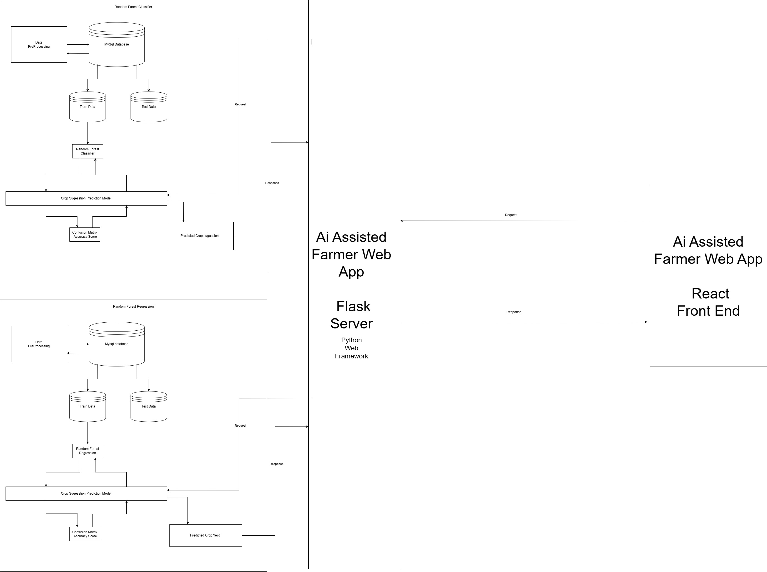
System Architecture

Slide 10
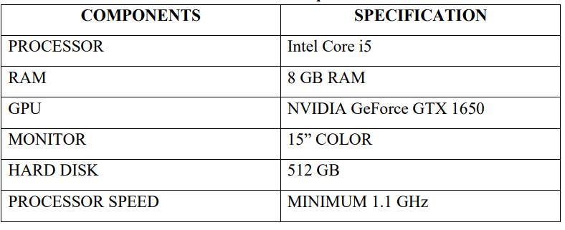
Software/Hardware Used
Hardware Requirements

Slide 11
Software Requirements
Machine Learning 2. Web 3.Front End
Scikit learn Flask React
Numpy
Pandas

Slide 12
Modules and its Description
Crop Recommendation Module
By using random forest classifier we will recommend the crop .
Because in recommendation we have to identify the crop which is suitable to the farmer’s situation .
No need to predict

Slide 13
Fertilizers Prediction Module
By using random forest regression we will predict the amount of fertilizers to be needed for the crops in the future.
Pesticides Prediction Module
With the help of random forest regression we will predict the amount of pesticides to be needed for the crops in the future.
Crop Yield Prediction Module
With the help of random forest regression we will predict the crop yield in the future.

Slide 14
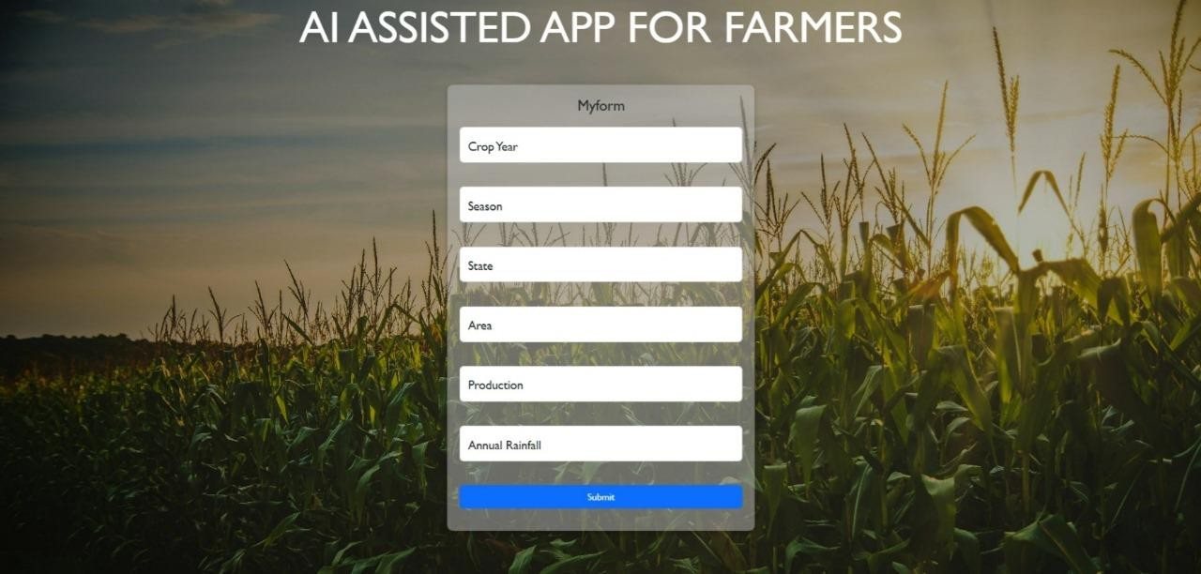
Result and Discussion
OUTPUT
UI OUTPUT
User Interface by which farmer enter the crop year,season,state,area,prediction,annual rainfall particulars to predict the crop yield, farming practices

Slide 15
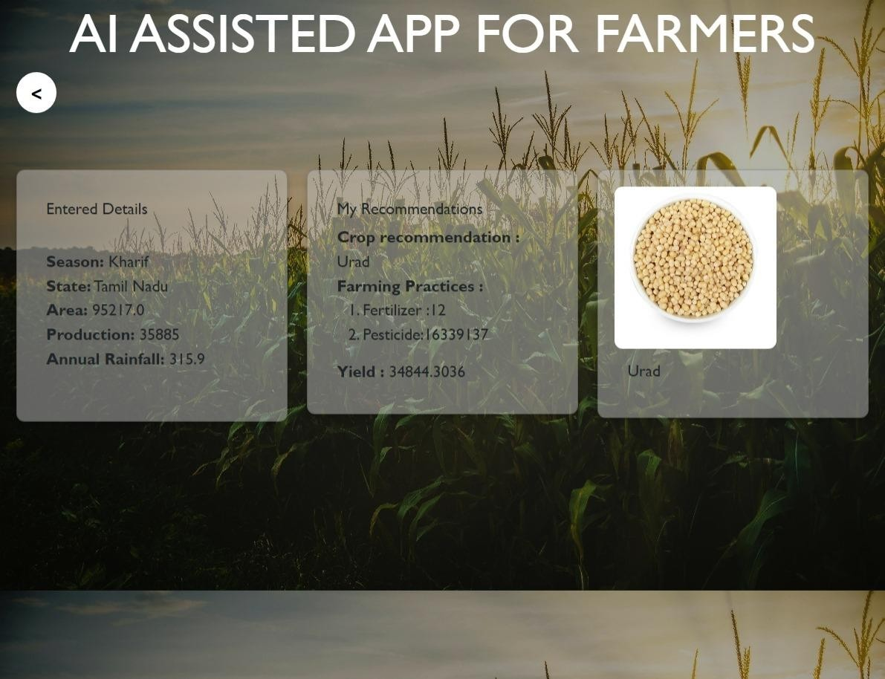
OUTPUT GENERATED BY OUR ML MODEL
ML MODEL OUTPUT
The model will make an analysis and give the output .And this output is very helpful for the farmer to make decision in the upcoming season.

Slide 16
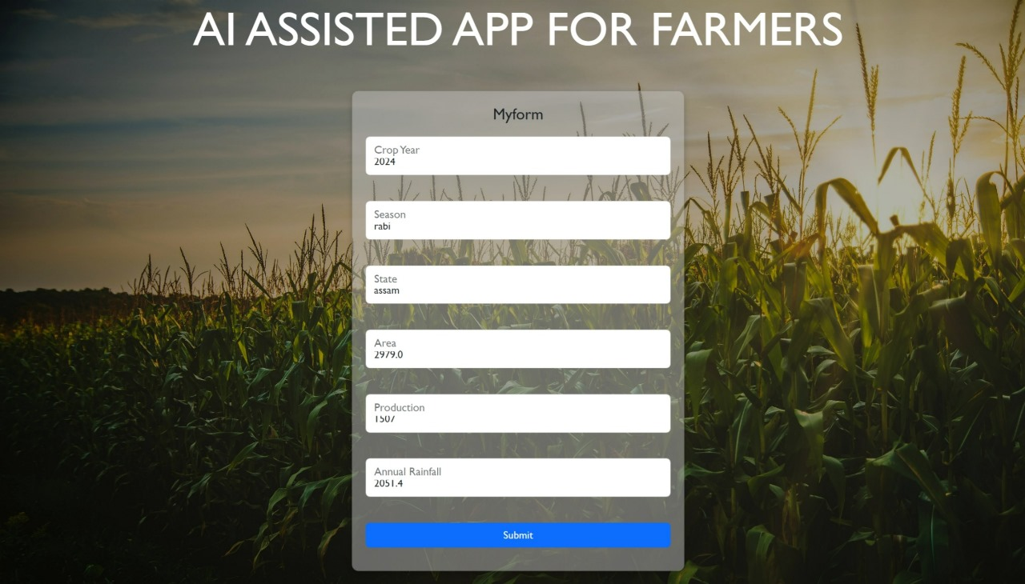
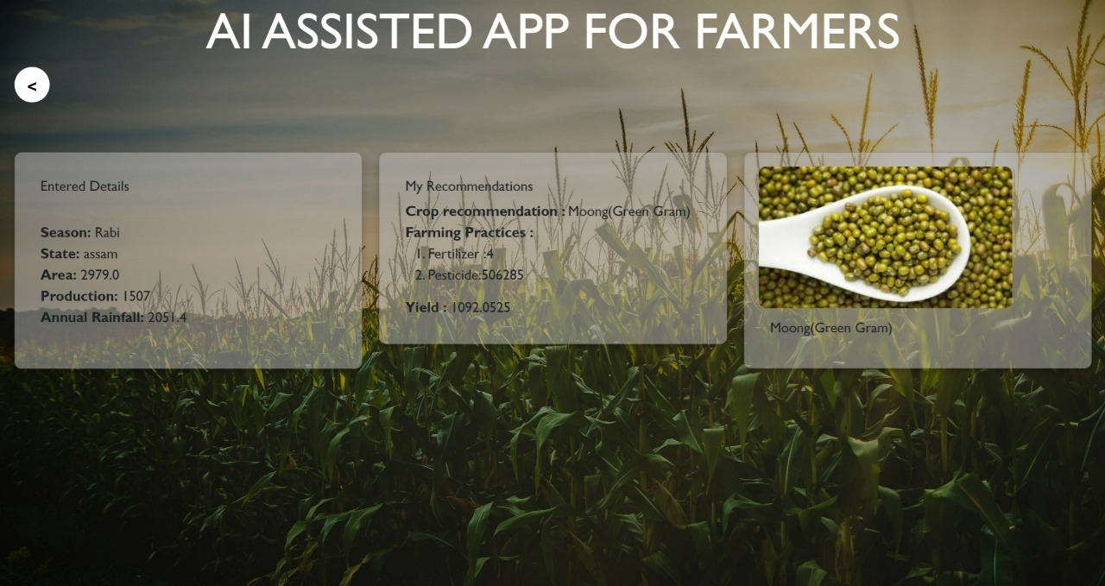
Different usecases
OUTPUT 2:
UI OUTPUT
ML MODEL OUTPUT

Slide 17
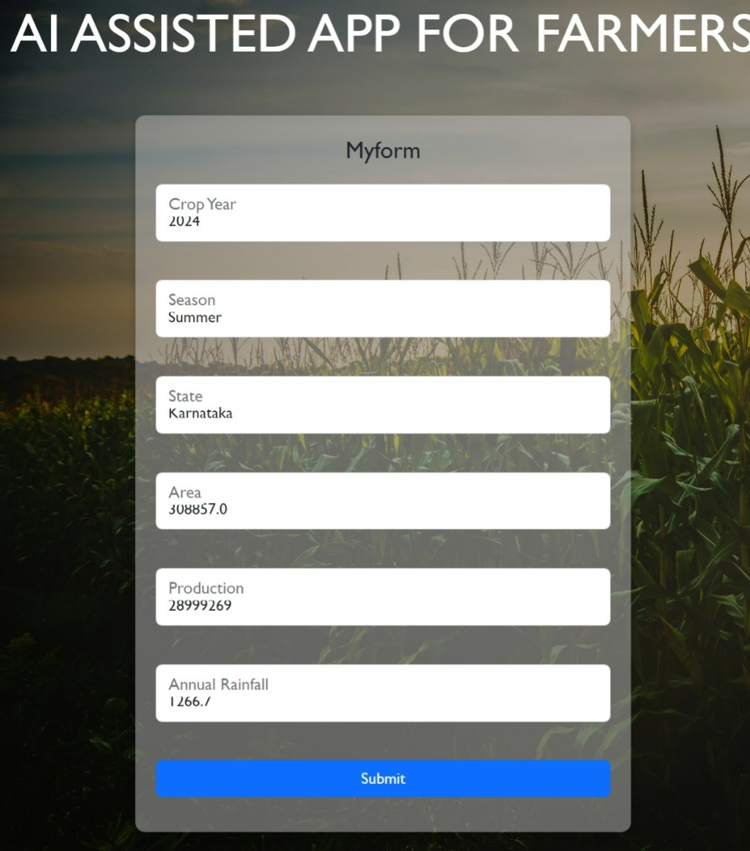
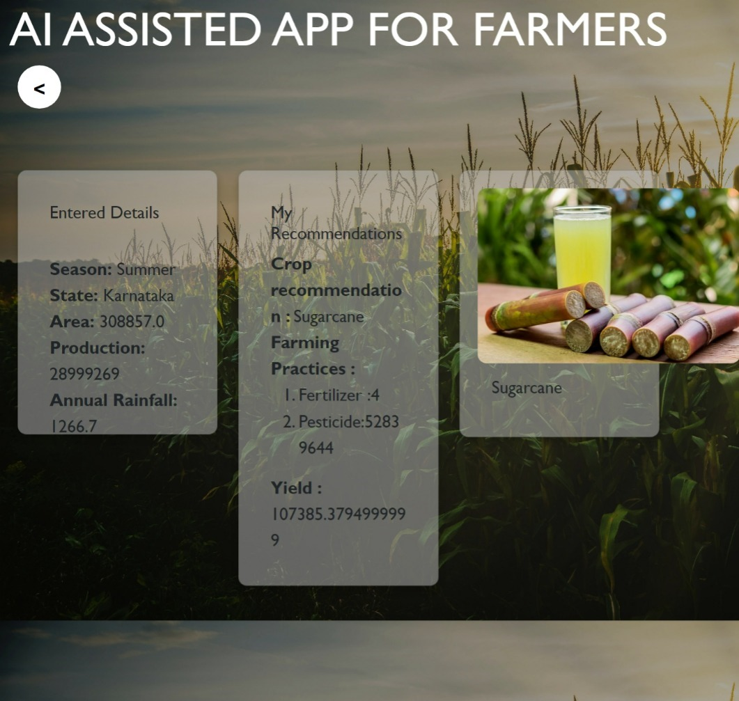
Different usecases
OUTPUT 3:
UI OUTPUT
ML MODEL OUTPUT

Slide 18
Conclusion
In summary, the Farm AI Companion project offers farmers a complete and technologically advanced solution to meet the issues they confront, marking a significant advancement in the evolution of agriculture.
Through the application of artificial intelligence, real-time data analytics, and community engagement, the initiative seeks to improve productivity, empower farmers with tailored insights, and advance sustainable farming methods.
By utilizing precision farming methods, optimum crop selection, the initiative has the potential to boost resistance to climate-related issues, enhance resource efficiency, and enhance agricultural yields.

Slide 19
Future Enhancements
Use more complex AI algorithm
Integration of IOT Devices
Use machine learning algorithms to recognize pest and diseases
Enhanced Language support

Slide 20
References
Himesh, S. Digital revolution and Big Data: A new revolution in agriculture. CAB Rev. 2018, 13, 1–7. [CrossRef]
Zhang, Y. The Role of Precision Agriculture. Resource 2019, 19, 9. 3.
Schimmelpfennig, D. Farm Profits and Adoption of Precision Agriculture. USDA 2016, 217, 1–46.
Grand View Research. Precision Farming Market Analysis. Estimates and Trend Analysis; Grand View Research Inc.: San Francisco, CA, USA, 2019; pp. 1–58.
Díez, C. Hacia una agricultural inteligence (Towards and intelligent Agriculture). Cuaderno de Campo 2017, 60, 4–11.

Slide 21
THANK YOU

